Slide 1
Storm events
Silvia Caldararu
Email: caldaras@tcd.ie

Slide 2
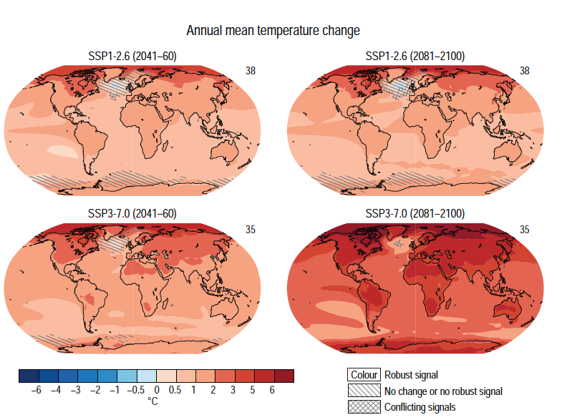
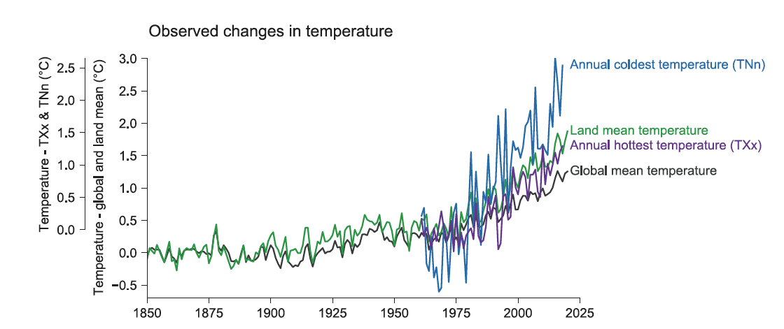
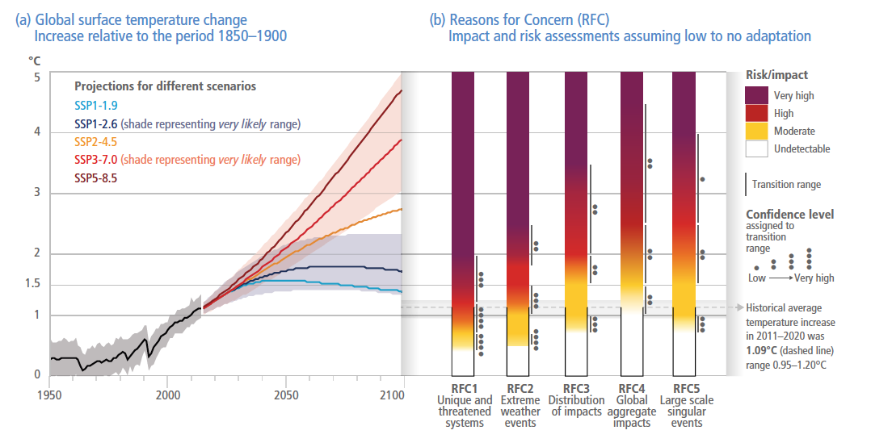
Mean climate, extreme events and their impacts
Average values in space and time
Extreme values of weather and climate
Impacts of mean and extreme values on ecosystems and the human population

Slide 3
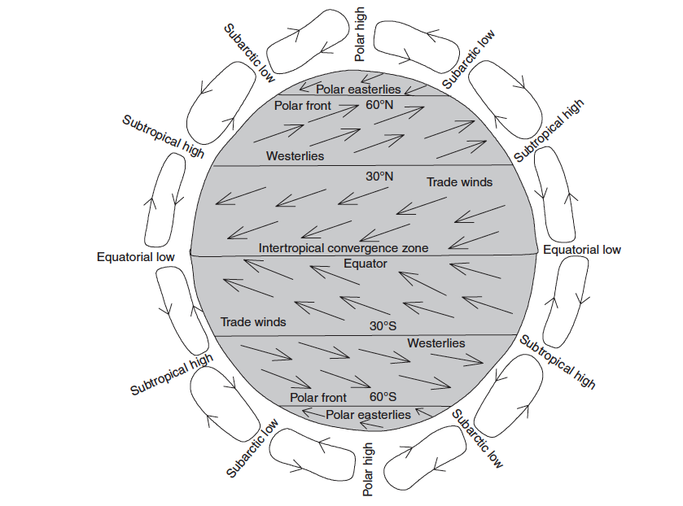
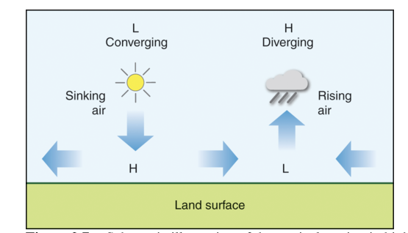
The global circulation recap
Air movement driven by differences in temperature and pressure
Higher wind speeds in areas of strong differences (isobars close to each other)

Slide 4
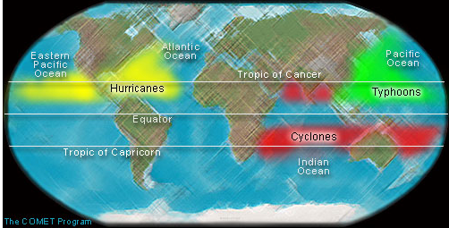
A hurricane by any other name

Slide 5
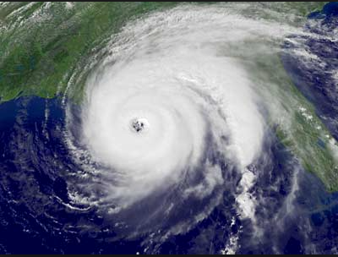
Tropical cyclone formation
Above warm waters (> 25ºC)
Driven by latent heat of evaporation
Do not form close to the equator, only between 5-20º latitude
Notes:
Essentials of the Earth's Climate System chapter 3.4

Slide 6
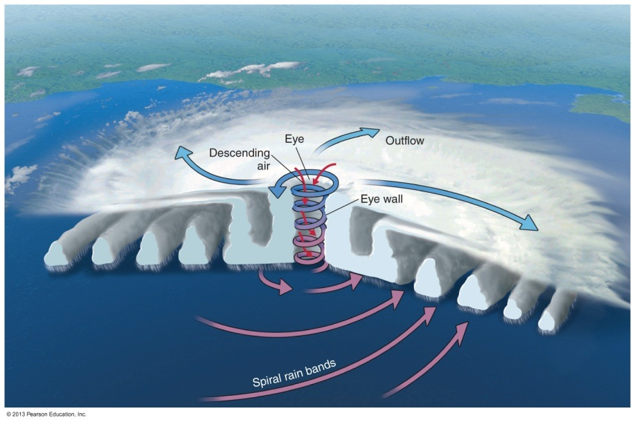
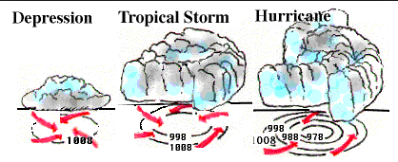
Tropical cyclone formation
Form around a zone of unstable conditions and are sustained by energy from evaporated water
Initially move east to west, plus rotation from Coriolis force. Eventually move northward.

Slide 7
Distribution in present day climate
Notes:
https://earthobservatory.nasa.gov/images/7079/historic-tropical-cyclone-tracks

Slide 8
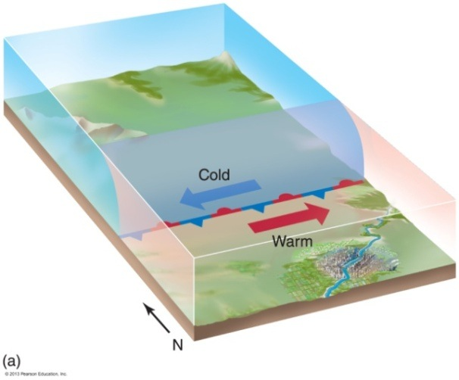
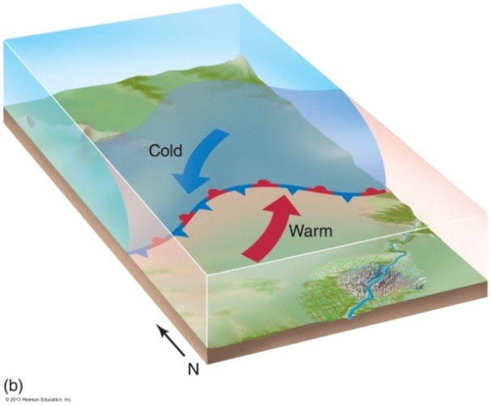
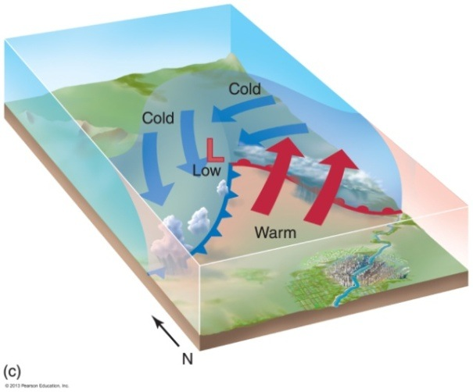
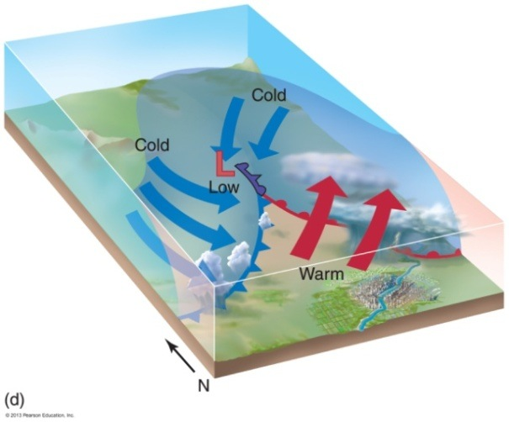
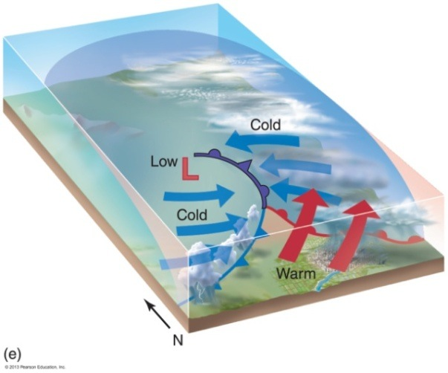
Extratropical cyclone formation

Slide 9
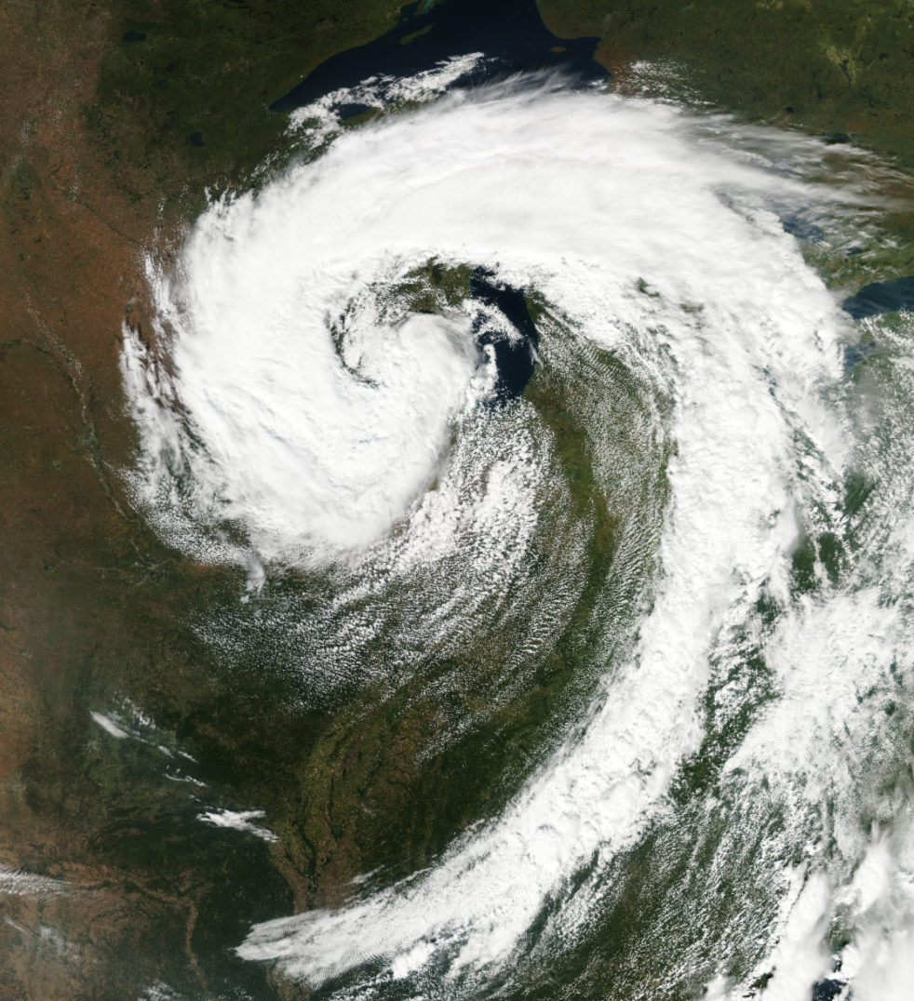
Extratropical cyclone formation
Extratropical cyclones form along boundaries between warm and cold air masses
Extratropical cyclones bring abrupt changes in wind, temperature, and sky conditions
Form over large areas of either land or sea, with variable wind speeds

Slide 10
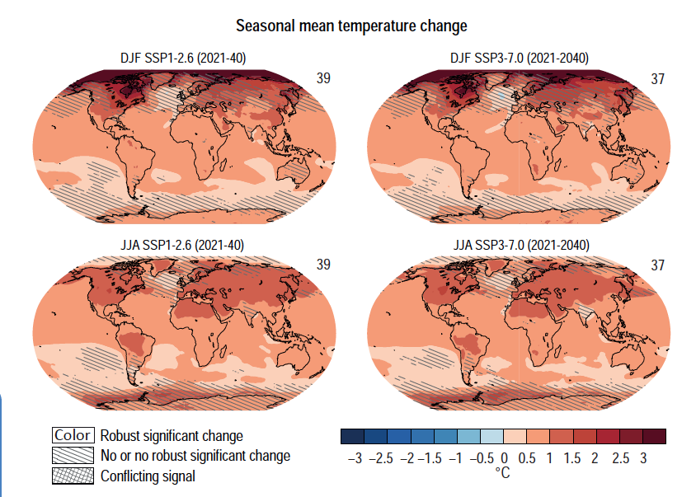
Would we expect tropical cyclone pattern and frequency to change under future climate? Why?
Higher sea surface temperature
Higher increase in temperature over land leads to stronger temperature gradients

Slide 11
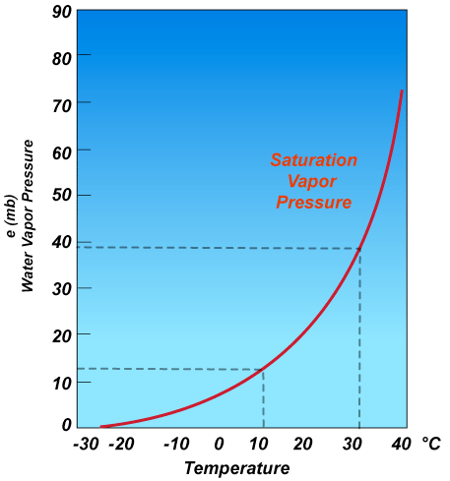
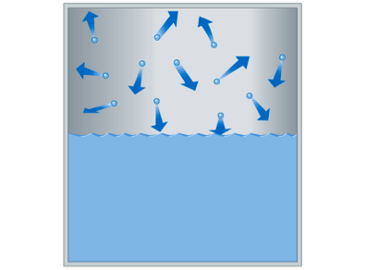
Would we expect tropical cyclone pattern and frequency to change under future climate? Why?
Higher temperature means higher evaporation and therefore more water vapour available

Slide 12
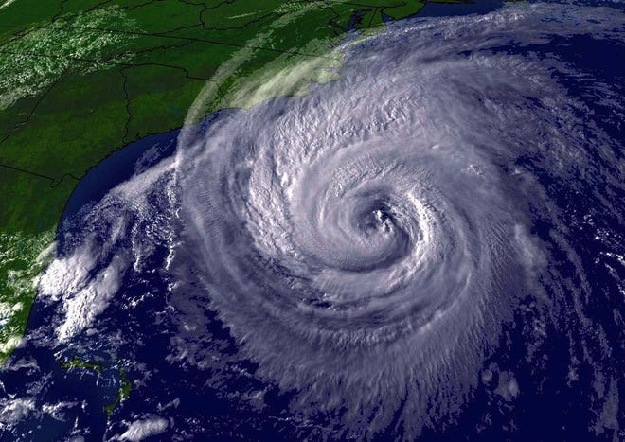
Difficulty in predicting storm events
Difficult to predict storm events because the spatial scale is finer than that of the models
Because they are infrequent, the historic data record is sparse, making it difficult to build and validate models

Slide 13
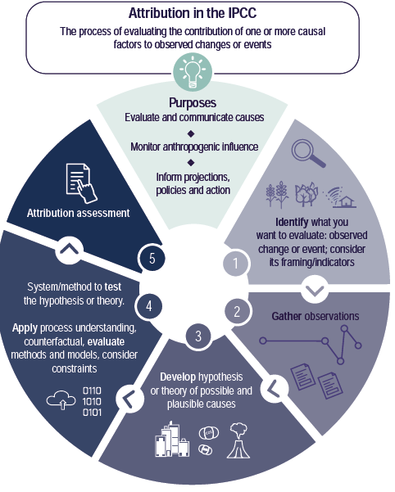
Difficulty in attributing extreme events
Extreme weather events occur naturally and contribute to climate variability
It is difficult to attribute individual storm events to climate change

Slide 14
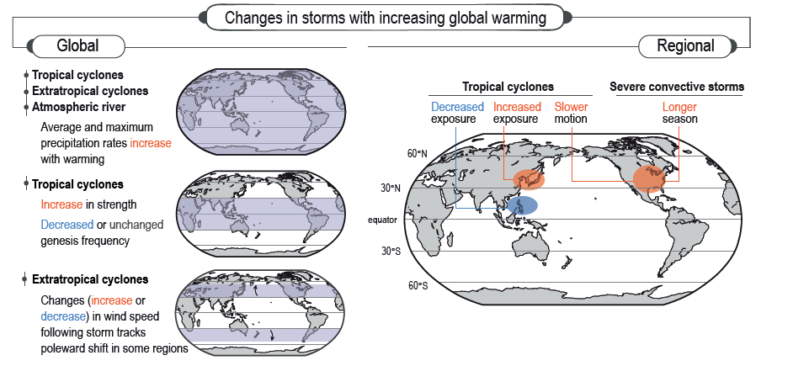
Observed changes in storm intensity and frequency
Notes:
IPCC WG I, chapter 11, figure 11.

Slide 15
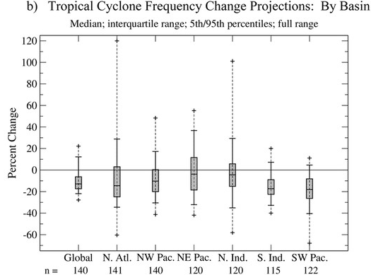
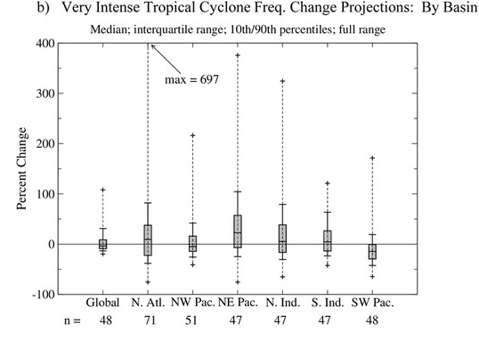
Projected changes in tropical cyclone frequency at 2º C warming
Overall decrease in the frequency of tropical cyclones
Increase in frequency of high intensity cyclones
Increase in precipitation from cyclones
Notes:
https://texmex.mit.edu/pub/emanuel/PAPERS/Knutson_etal_2020.pdf

Slide 16
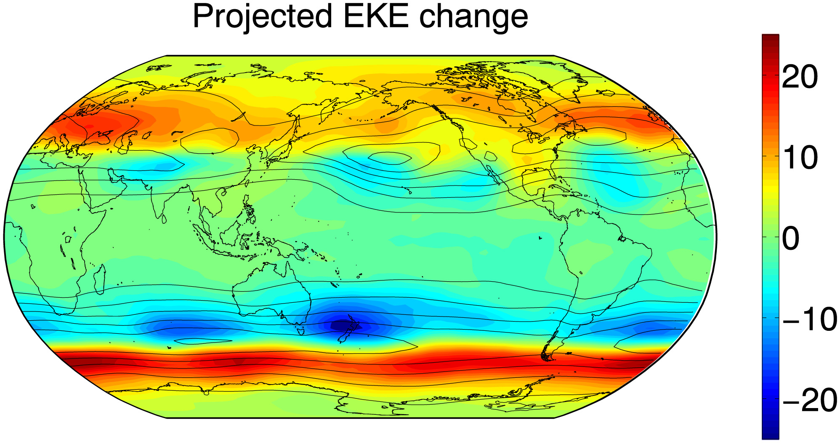
Poleward shift in extratropical storm tracks
Changes in wind intensity over the 21st century from a high end emission scenario
Higher windspeeds shifting towards higher latitudes
Caused by changes in temperature patterns
Notes:
https://www.pnas.org/doi/10.1073/pnas.1812312116#:~:text=Projections%20of%2021st%20century%20climate,the%20projections%20in%20this%20season

Slide 17
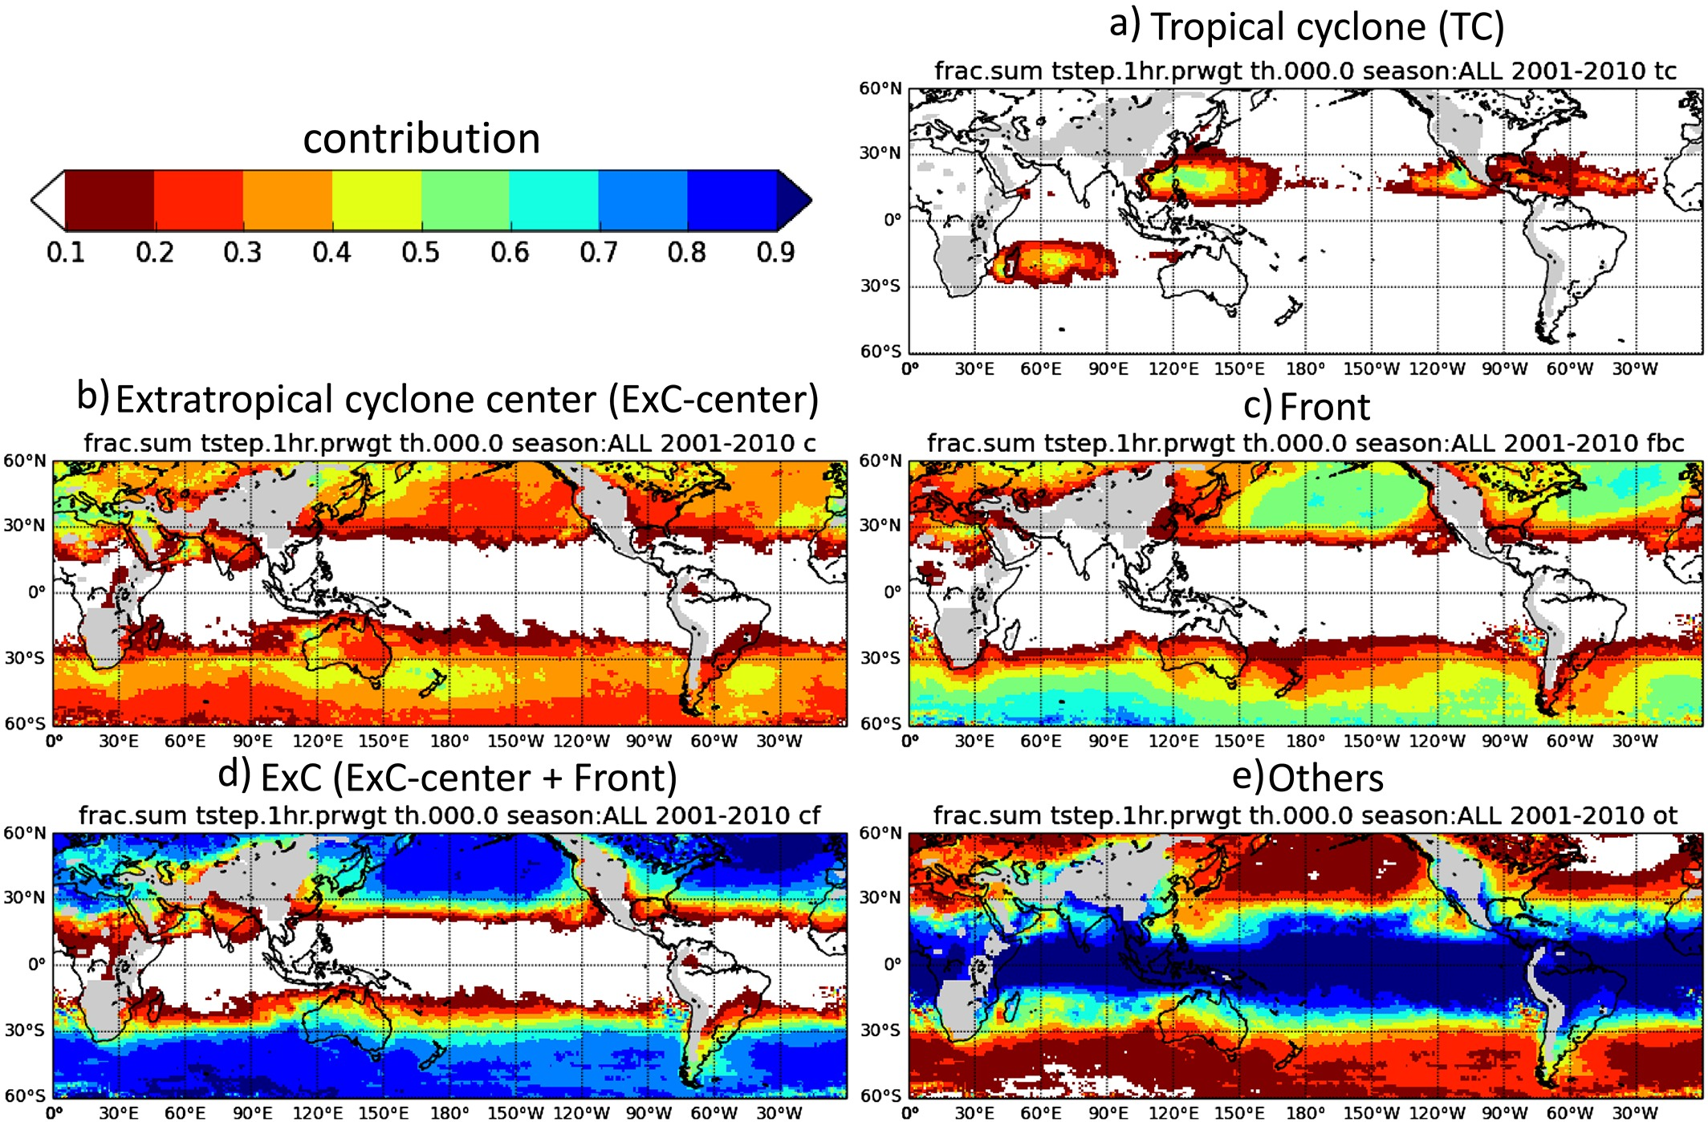
Rainfall contribution from cyclones
Tropical cyclones contribute a relatively small amount of total yearly precipitation
Extratropical cyclones contribute the majority of yearly precipitation
Notes:
https://agupubs.onlinelibrary.wiley.com/doi/full/10.1002/2016JD025222

Slide 18
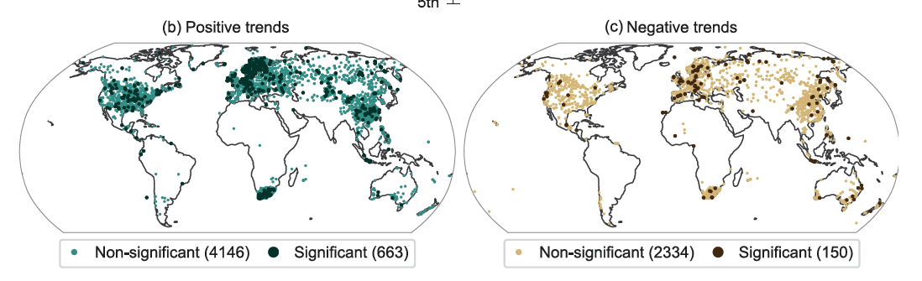
Observed changes in extreme rainfall
Very heterogenous pattern. Extreme rain is very local!
Note bias in geographical distribution of data
Notes:
IPCC WG I, chapter 11, figure 11.13

Slide 19
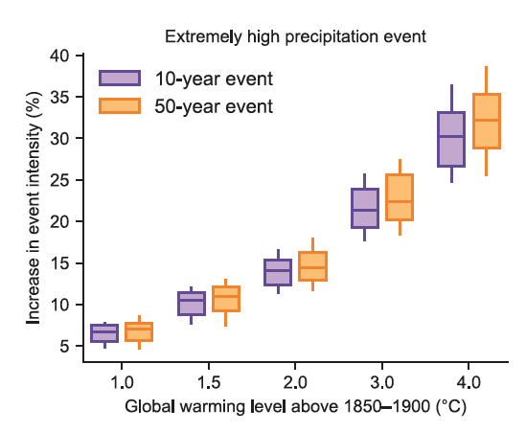
Projected changes in extreme rainfall frequency
Increase in extremums at higher warming levels
Similar relative increase for 10-year and 50-year events
Remember these numbers are used for infrastructure planning
Notes:
IPCC WG I, chapter 11, figure 11.15

Slide 20
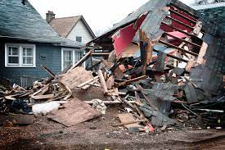
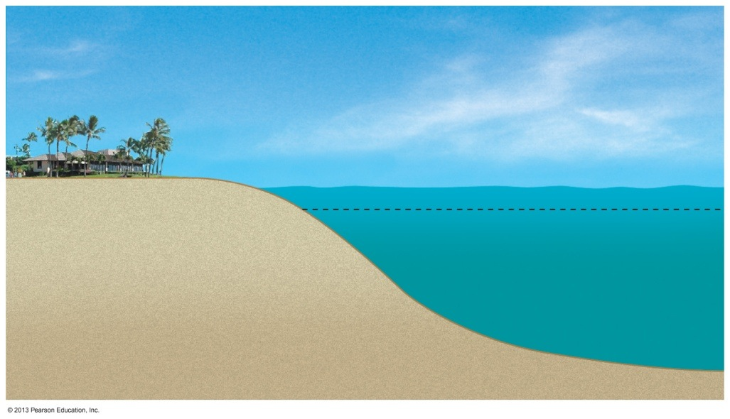
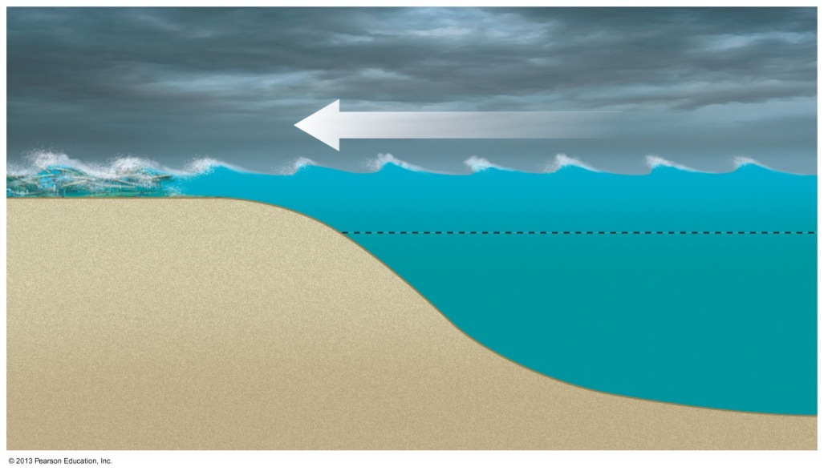
Impacts of tropical cyclones
High winds and high intensity rainfall
Storm surge – compound effects with sea level rise

Slide 21
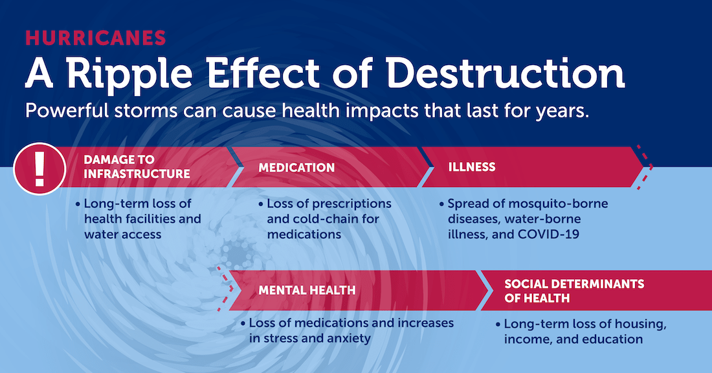
Impacts of tropical cyclones: aftermath
Effects of storm damage propagate in time
Often affect poorest areas

Slide 22
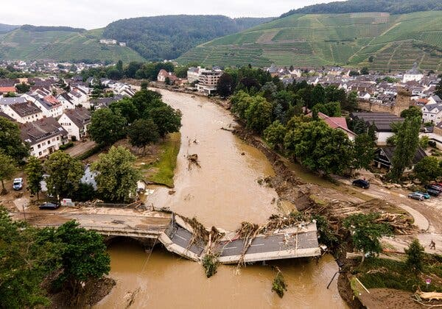
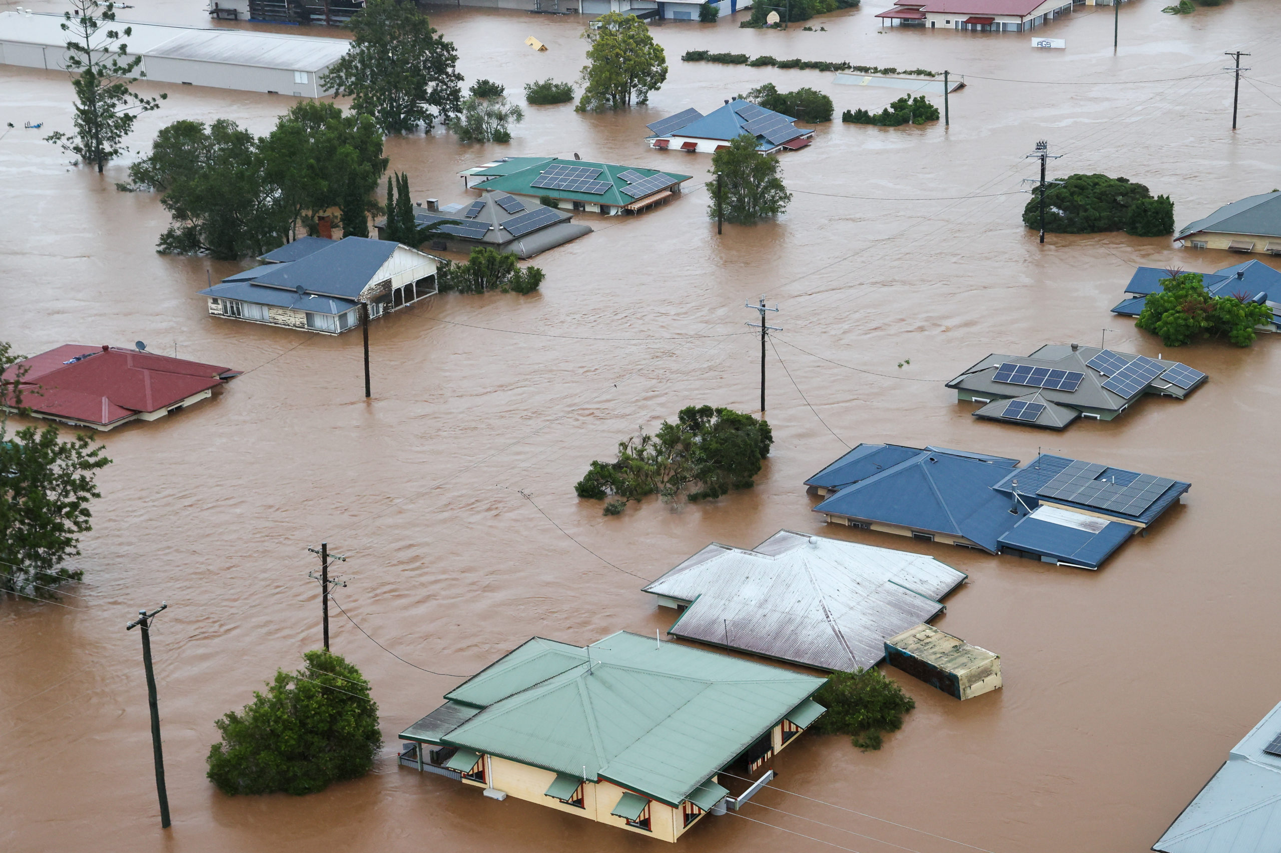
Impacts of extreme rainfall: flooding
Humans often live near rivers and on flood plains
Infrastructure designed to withstand historical levels of precipitation

Slide 23
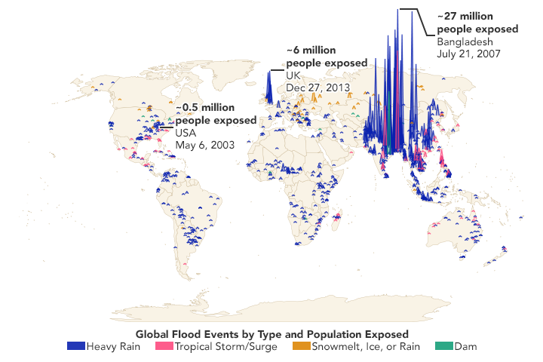
A lot of people live on flood plains
Notes:
https://www.nature.com/articles/s41586-021-03695-w

Slide 24
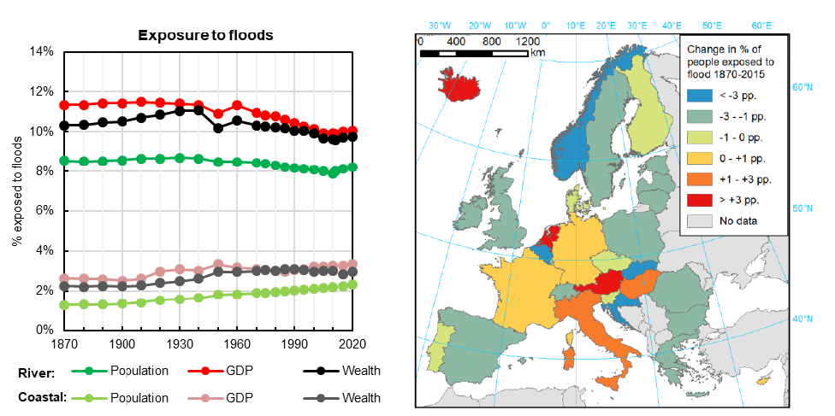
Europe flood data
Notes:
https://www.nature.com/articles/s41467-018-04253-1

Slide 25
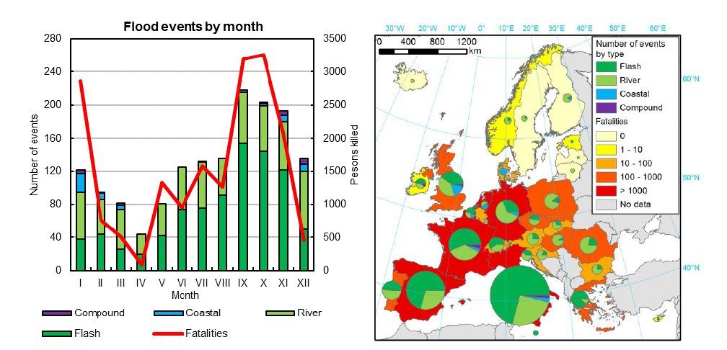
Europe flood data
Notes:
https://www.nature.com/articles/s41467-018-04253-1

Slide 26
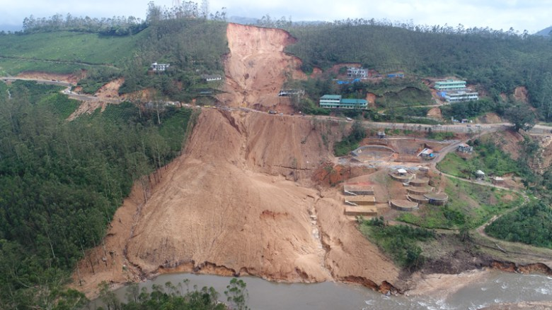
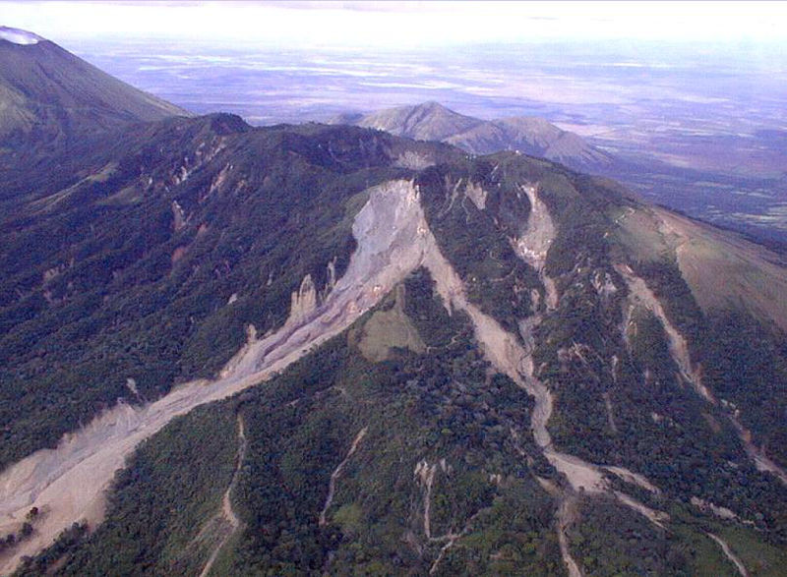
Impacts of extreme rainfall: erosion and landslides
Sudden movement of rock or soil
Material can become unstable under sudden added weight of water

Slide 27
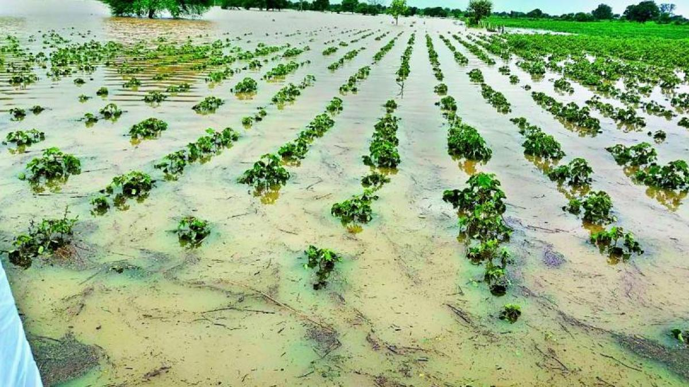
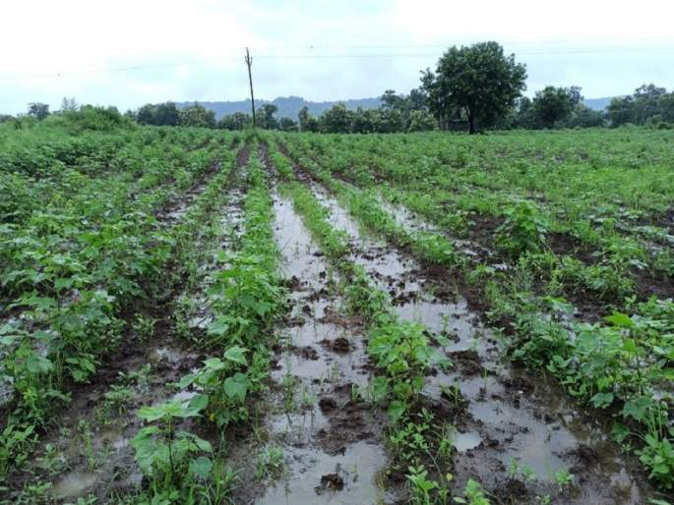
Impacts of extreme rainfall: crop damage
Standing water leads to anoxic soil conditions
Plant roots cannot respire and die

Slide 28
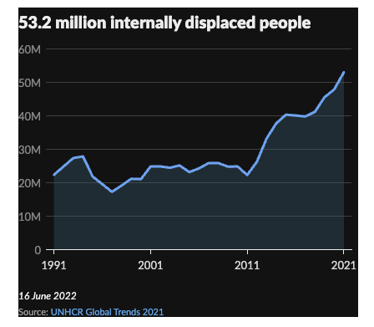
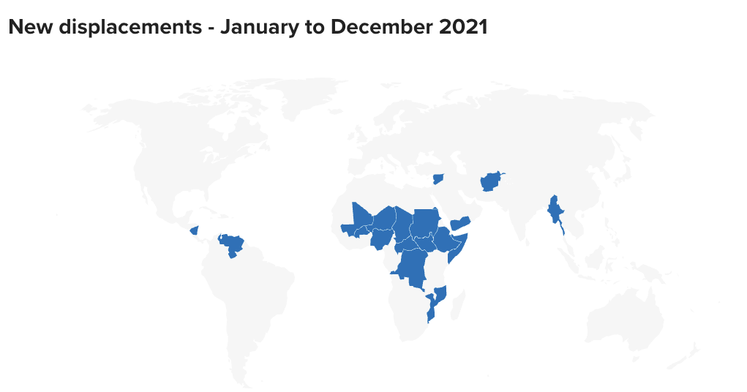
Impacts: displacement and migration
Climate change – including droughts and floods – enhances conflict and migration

Slide 29
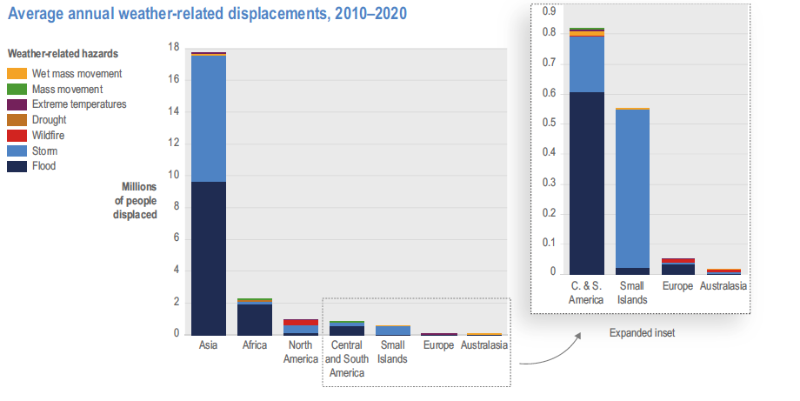
Impacts: displacement and migration
Notes:
IPCC WG II, chapter 7, figure 7.7

Slide 30
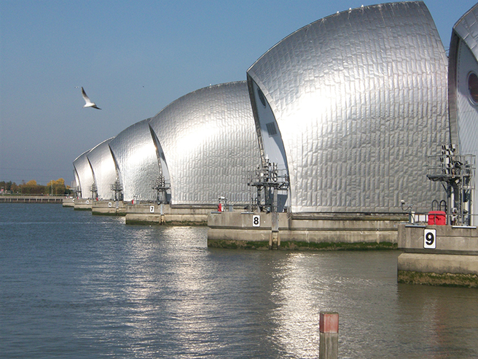
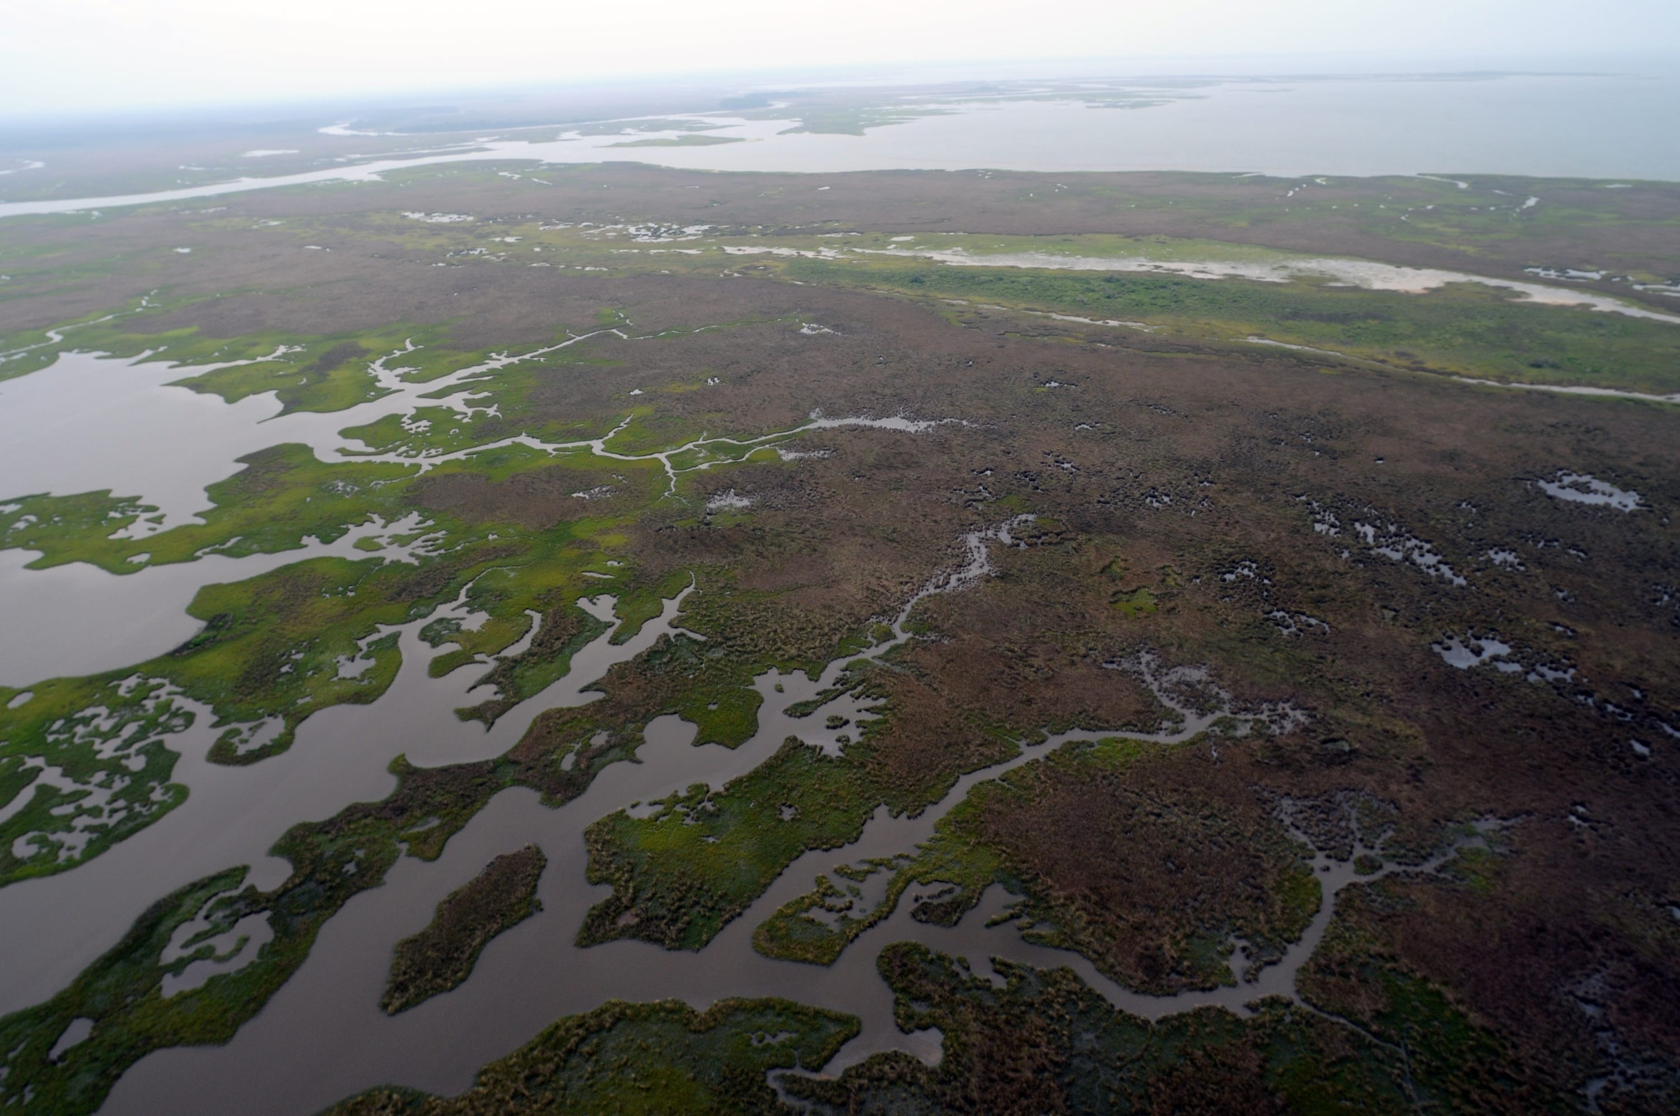

What can we do? Flood defences
Either built or ecosystem barriers
Built infrastructure needs to be designed with new risk levels in mind

Slide 31
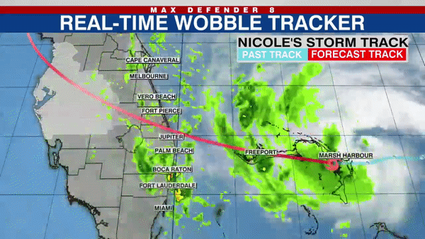
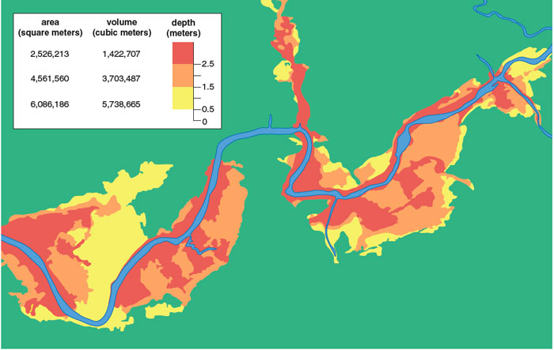
What can we do? Real time forecasts
More data and earth science knowledge than ever before leads to real time accurate forecasts
Lead to less lives and property lost

Slide 32
What is a forecast?
Short-term, high resolution prediction
Uses similar models to earth system models but with a local rather than global focus
Relies on real tiem data and is constantly improved

Slide 33

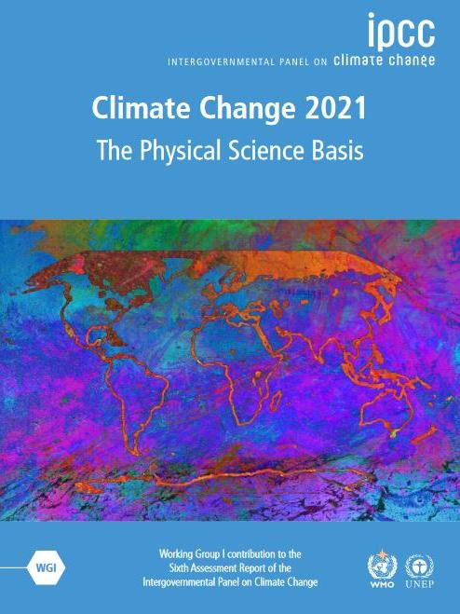
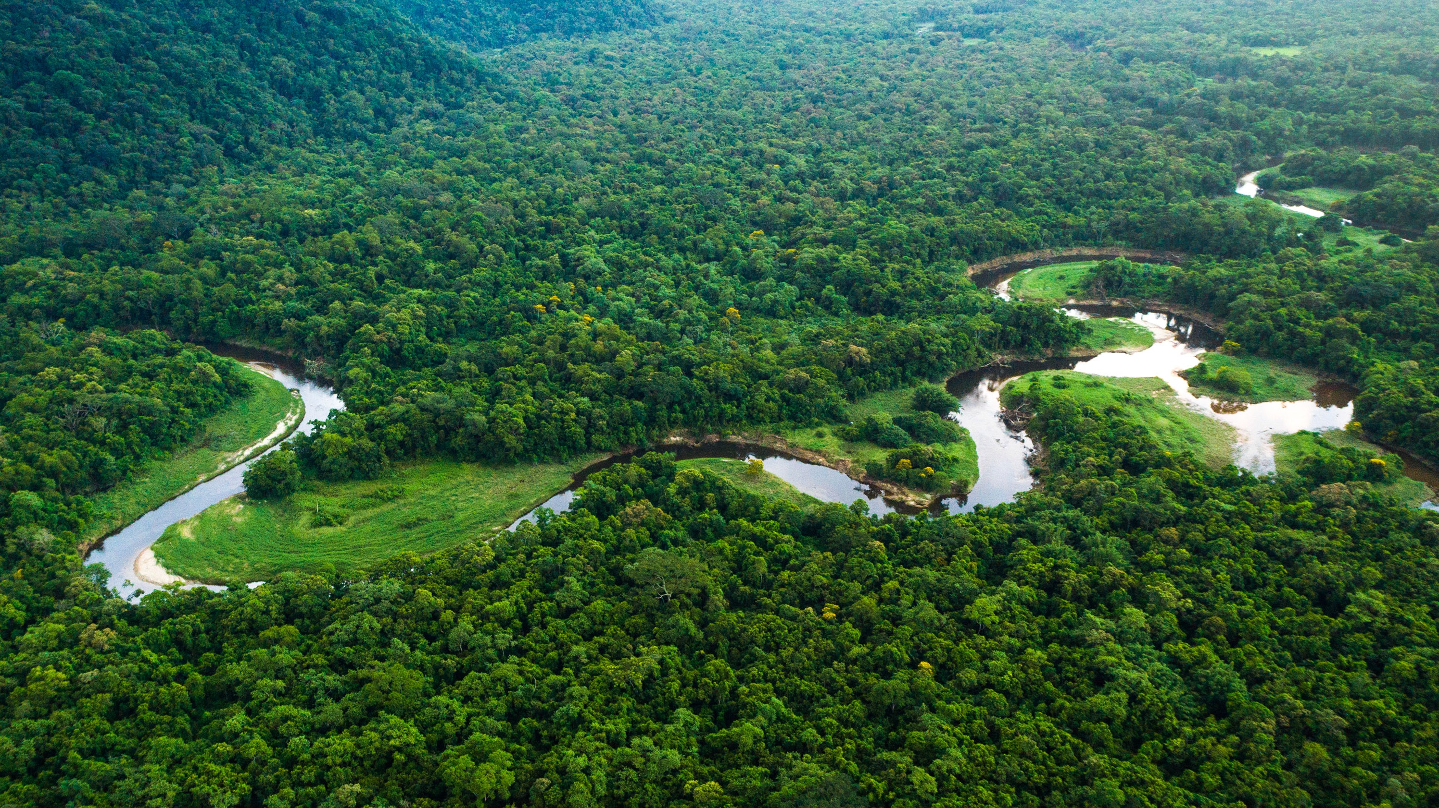

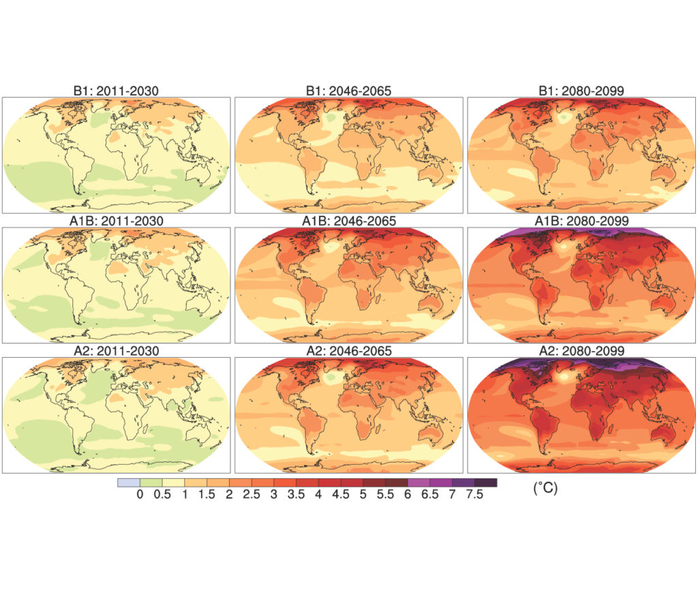



Atmosphere
Climate fundamentals
Predicting climate
Atmosphere
Global C cycle
IPCC report
Earth system models
Climate impacts
Climate solutions
Extreme events
Tipping points
Sea ice, ice caps
Energy
Mitigation
Nature-based solutions

